Slide 1
Single View 3D Object Reconstruction (Guided Research)
Parika Goel
Advisor : Dr. Angela Dai
Supervisor : Prof. Dr. Matthias Nießner

Slide 2
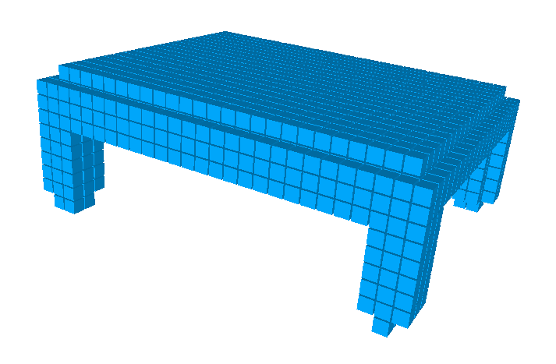
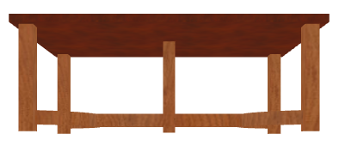
Goal : 3D Reconstruction from Images

Slide 3
Motivation
Robotics
Augmented Reality
3D Printing
3D Reconstruction Applications
Interior Design
Gaming Industry
E-Commerce
Notes:
Talk about how it is useful in some of these applications
For good 3D reconstruction, require images from multiple view points with view point information, or 3D shape information
Would be interesting if able to create models from single image by using some prior knowledge
No standard representation for 3D : could be voxels, meshes, point clouds
Voxels : Regular grid structure
Next 3 slides talk about some of the works which has been done for reconstructing from single image using voxel representation

Slide 4

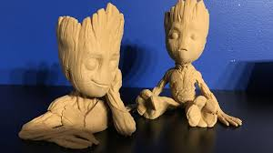

Motivation : 3D Printing

Slide 5
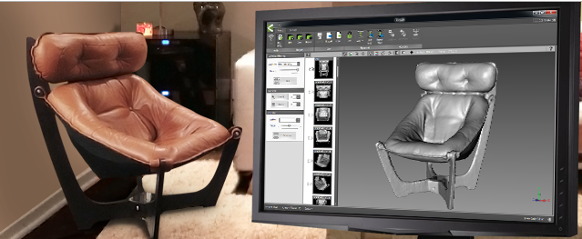

Motivation : Interior Design
https://sketchfab.com/

Slide 6
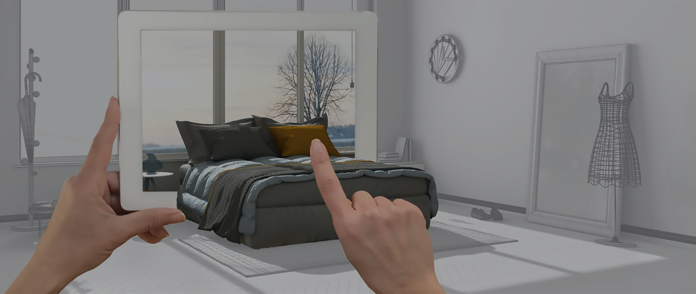
Motivation : Augmented Reality
https://program-ace.com/blog/photogrammetry-in-ar/
Notes:
Talk about how it is useful in some of these applications
No standard representation for 3D : could be voxels, meshes, point clouds
Voxels : Regular grid structure
For good 3D reconstruction, require images from multiple view points with view point information, or 3D shape information
Would be interesting if able to create models from single image by using some prior knowledge
Next 3 slides talk about some of the works which has been done for reconstructing from single image using voxel representation

Slide 7
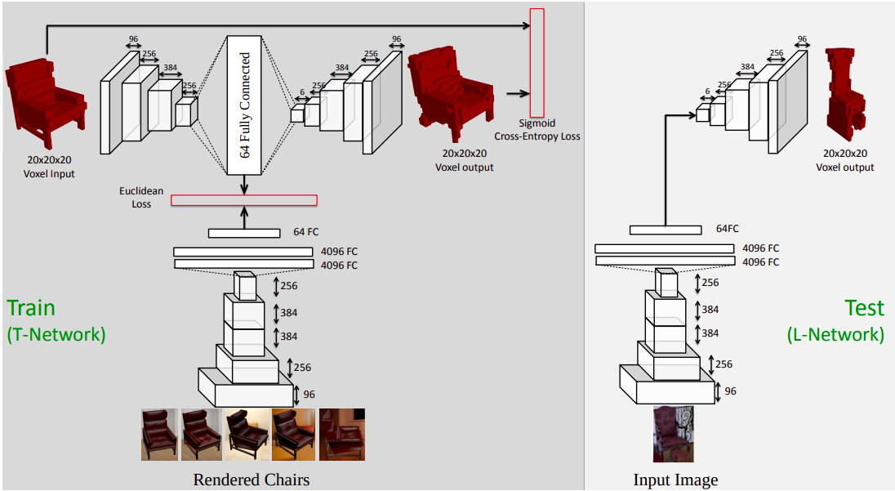
Related Work
Learning a Predictable and Generative Vector Representation for Objects. Girdhar et al. 2016
https://arxiv.org/pdf/1603.08637.pdf

Slide 8
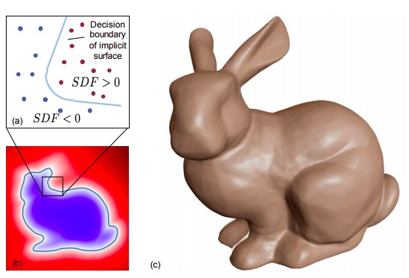
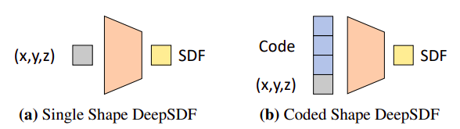
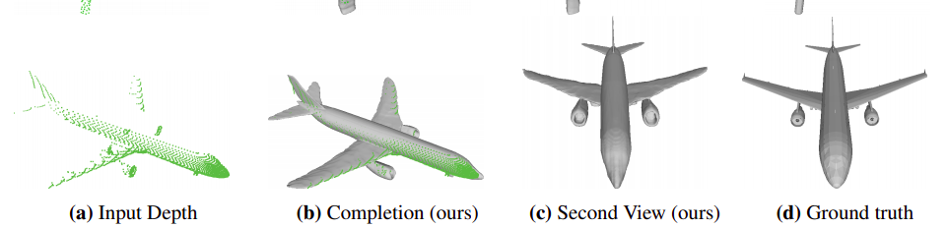
Related Work
DeepSDF: Learning Continuous Signed Distance Functions for Shape Representation. Park et al. 2019
https://arxiv.org/pdf/1901.05103.pdf

Slide 9
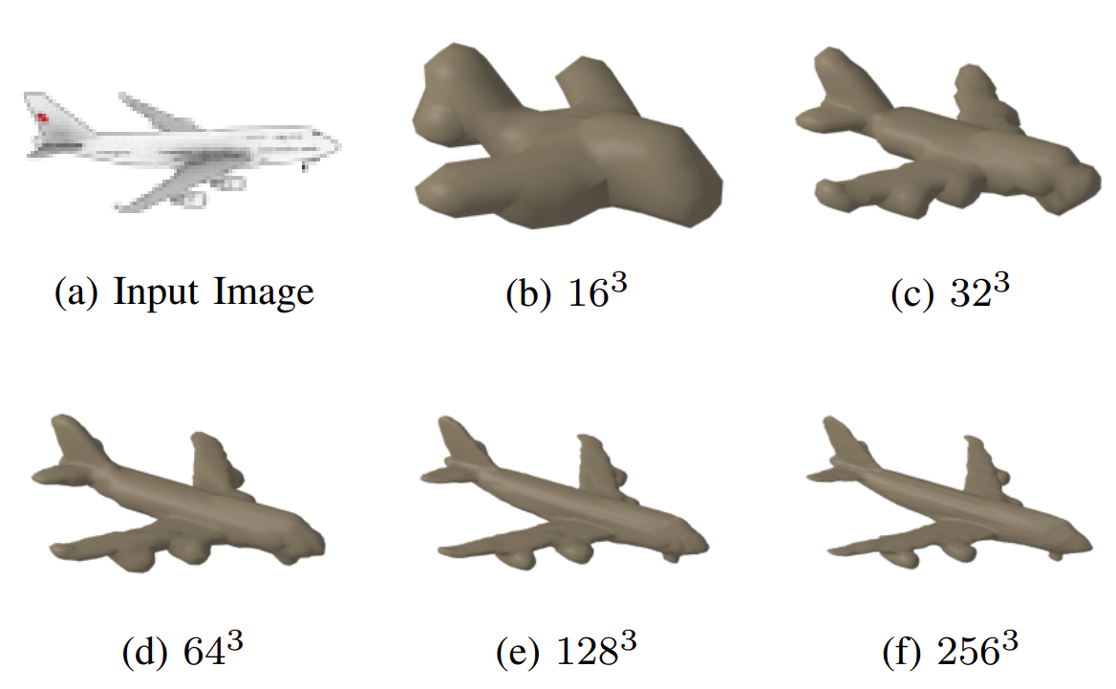
Related Work
Hierarchical Surface Prediction for 3D Object Reconstruction. Hane et al. 2017
https://arxiv.org/pdf/1704.00710.pdf

Slide 10
Contribution
Comparison of Occupancy Grid and Distance Field Representation for the task of 3D Reconstruction
Comparison of two network architectures (Net3D vs UNet3D) for the task of 3D Reconstruction

Slide 11
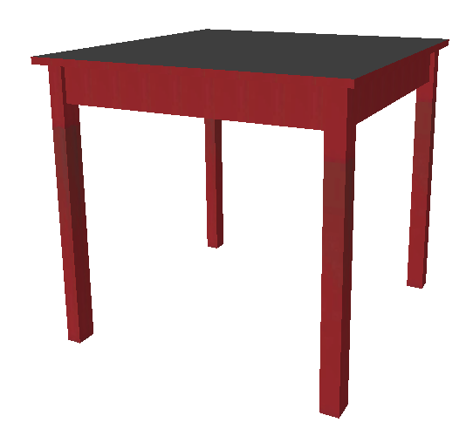
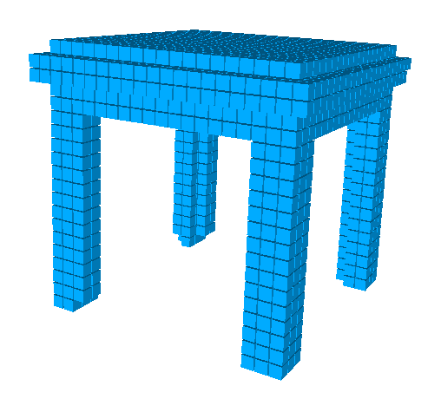
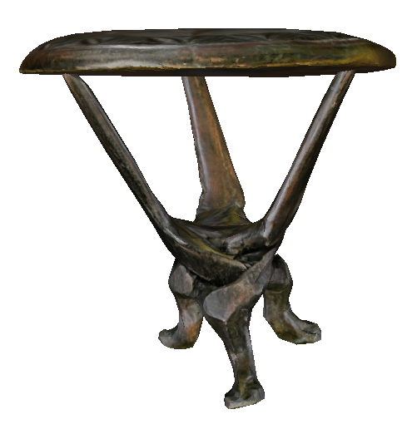
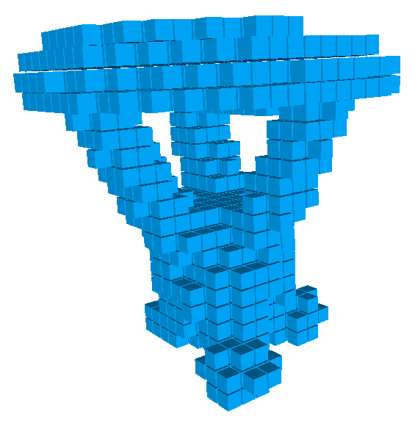
Data Generation
Ground Truth: Voxelize shapenet table from .obj
https://github.com/christopherbatty/SDFGen

Slide 12
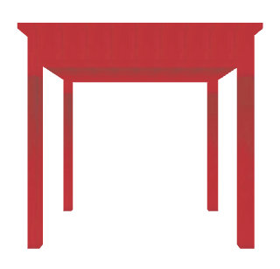
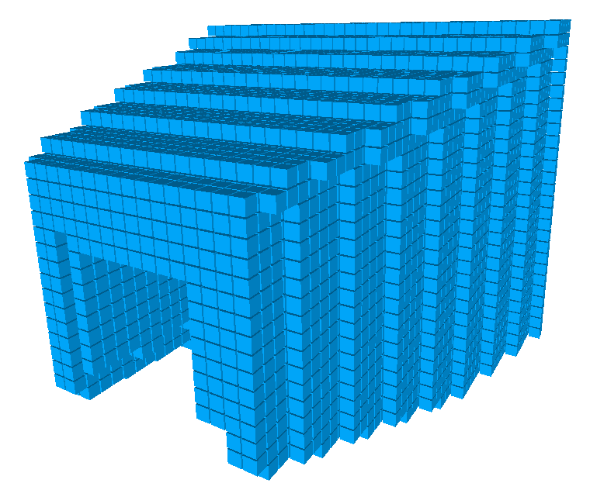
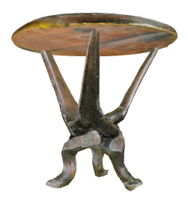
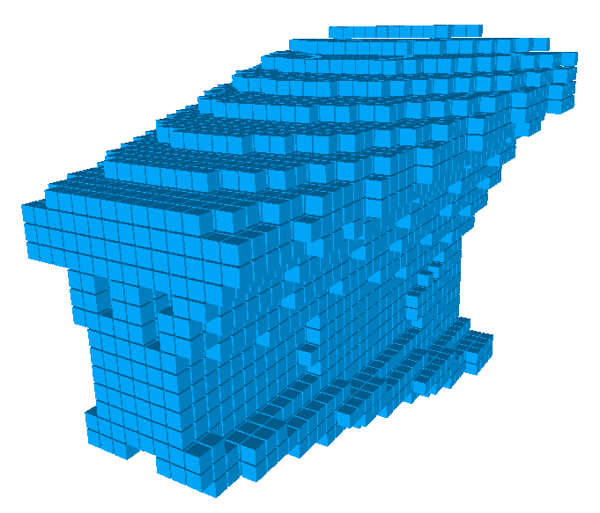
Data Generation
3D Input : Generate Visual Cones from input 2D images

Slide 13
Data Generation
3D Input : Generate Visual Cones from input 2D images
Camera
Voxel Grid
Ray shot through
the pixel
Image Plane

Slide 14
Data Generation
3D Input : Generate Visual Cones from input 2D images
Camera
Voxel Grid
Ray shot through
the pixel
Image Plane

Slide 15
Data Generation
3D Input : Generate Visual Cones from input 2D images

Slide 16
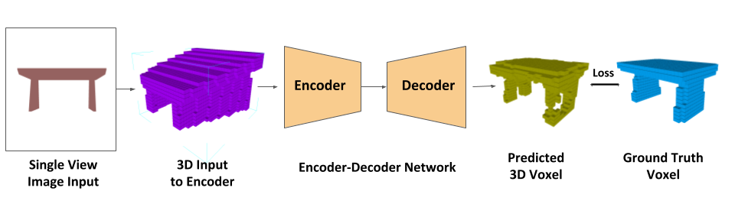
System Pipeline

Slide 17
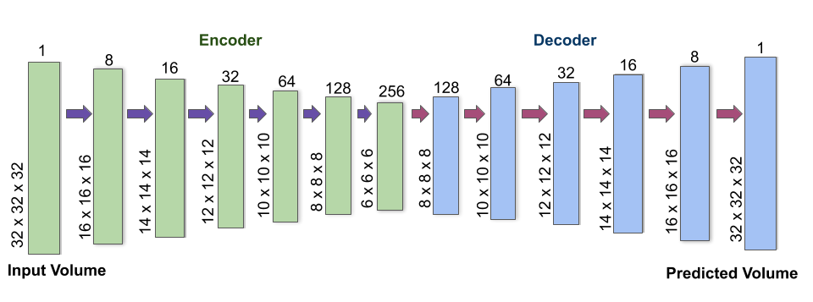
Network Architecture : Net3D
All layers have Instance normalization and ReLU
Except the last layer
Notes:
Encoder
6 Conv Layers : 8, 16, 32, 64, 128, 256 channels
Kernel size of 3x3
Stride 1 (except first Conv Layer : Stride 2 and padding 1)
Decoder
6 Transposed Conv layers : 128, 64, 32, 16, 8, 1 channels
Kernel size of 3x3
Stride 1 (except last Conv Layer : Stride 2, Padding 1 and Output Padding 1)
All convolution layers are followed by instance normalization and relu except the last layer

Slide 18
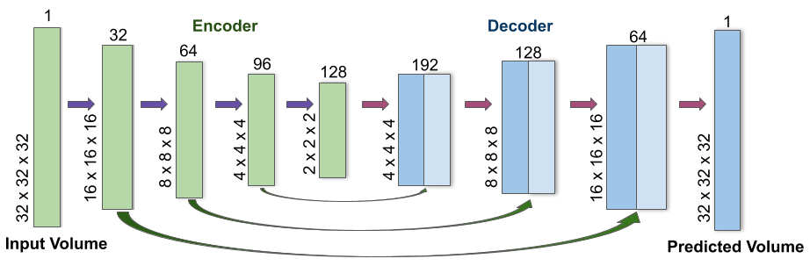
Network Architecture: UNet3D
All layers have Instance normalization and ReLU
Except the last layer
Notes:
Encoder
4 Conv Layers : 32, 64, 96, 128 channels
Kernel size of 3x3
Stride 2 and padding 1
Decoder
4 Transposed Conv layers : 96, 64, 32, 1 channels
Kernel size of 3x3
Stride 2, Padding 1 and Output Padding 1

Slide 19
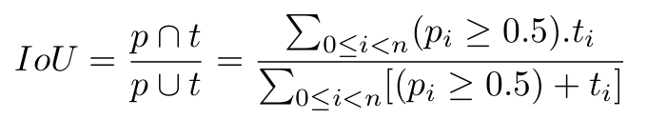
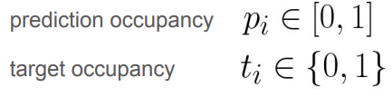
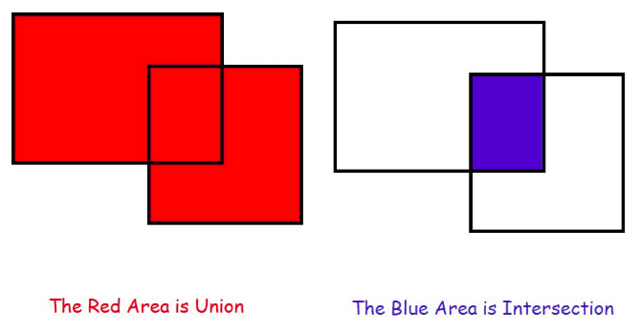
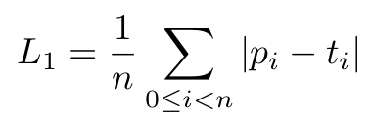
Evaluation Metrics
Intersection Over Union (IoU)
L1 Error Metric

Slide 20
Evaluation : Occupancy Grid vs Distance Field
 | IoU ↑ | L1-Error ↓
Occupancy | 0.592 | 0.118
TDF | 0.583 | 0.114
TDF(log) | 0.597 | 0.111
Notes:
For training, we have used the Adam optimizer with a learning rate of 0.001 and weight decay of 1e-5. The learning rate is decayed by half after every 10 epochs. We train the network for 50 epochs with the batch size of 8

Slide 21
Evaluation : Occupancy Grid vs Distance Field
Distance Field with log weighting performs better than other two versions.
more weightage to the voxels near the surface.
Occupancy representation performs better than Distance Field representation
Lesser to learn
Input is in the form of occupancy
In terms of speed, Occupancy representation performs better than other two versions
Occupancy: 26 epochs
Distance Field with log weighting: 43 epochs
Notes:
For training, we have used the Adam optimizer with a learning rate of 0.001 and weight decay of 1e-5. The learning rate is decayed by half after every 10 epochs. We train the network for 50 epochs with the batch size of 8
Distance Field : 45 epochs

Slide 22
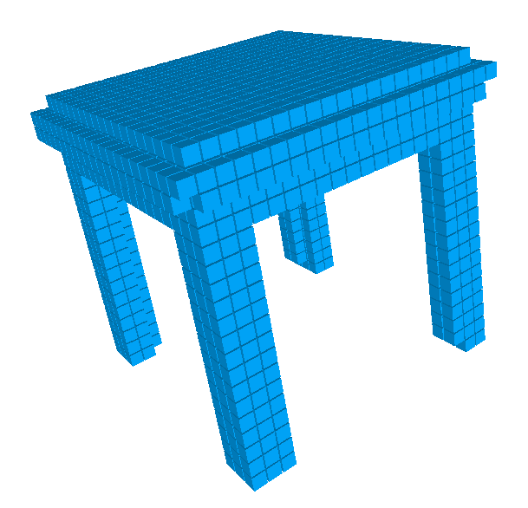
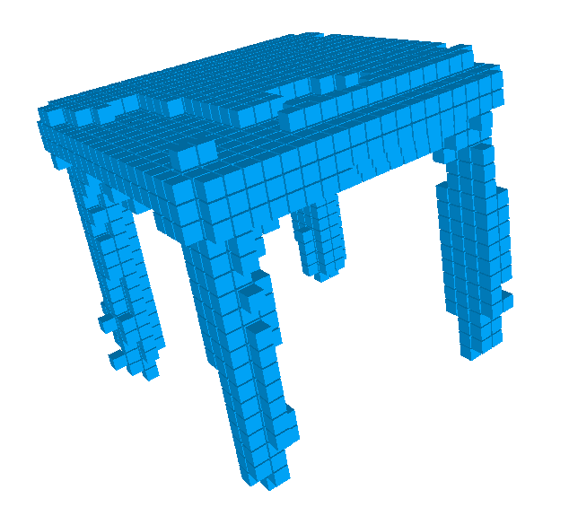
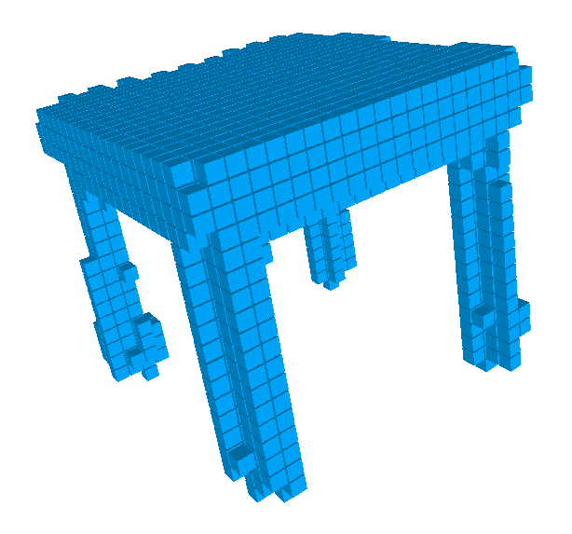
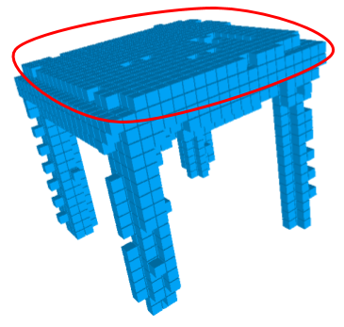
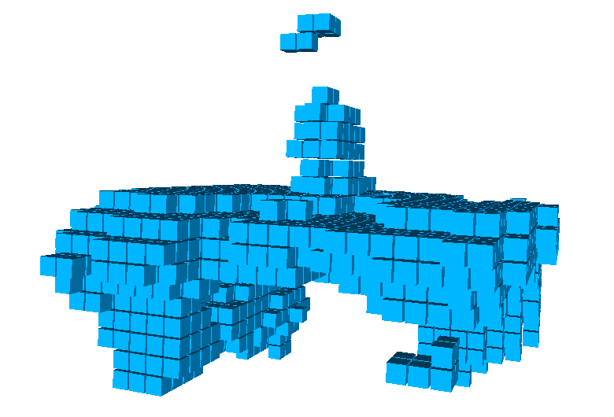
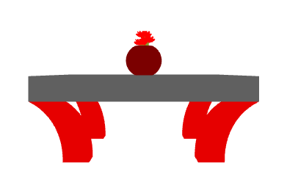
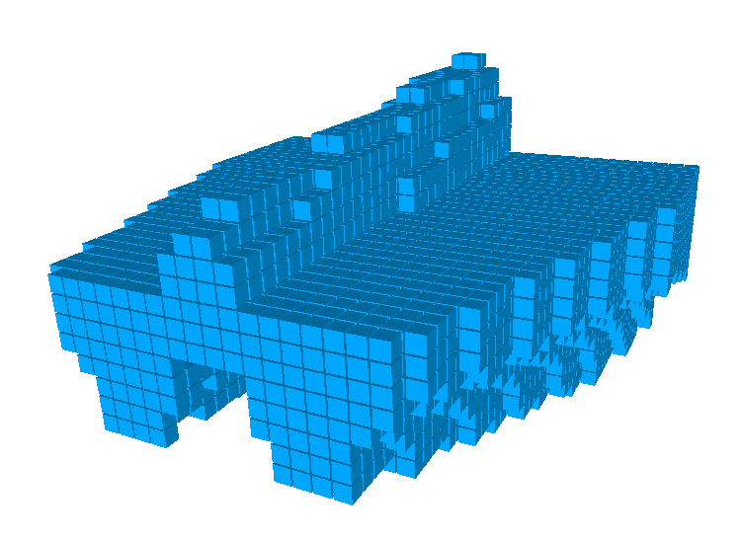
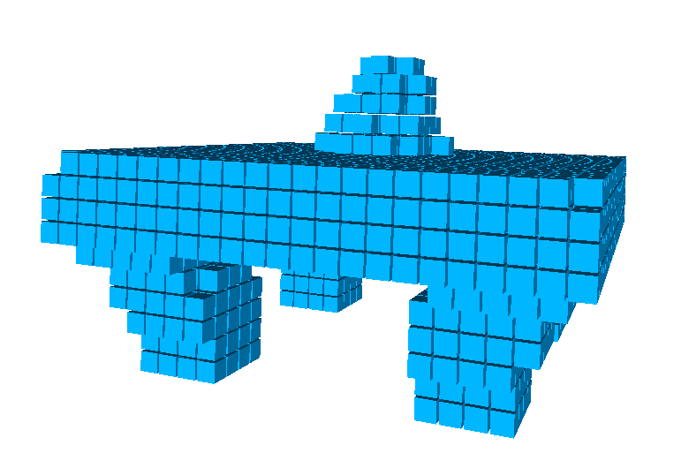
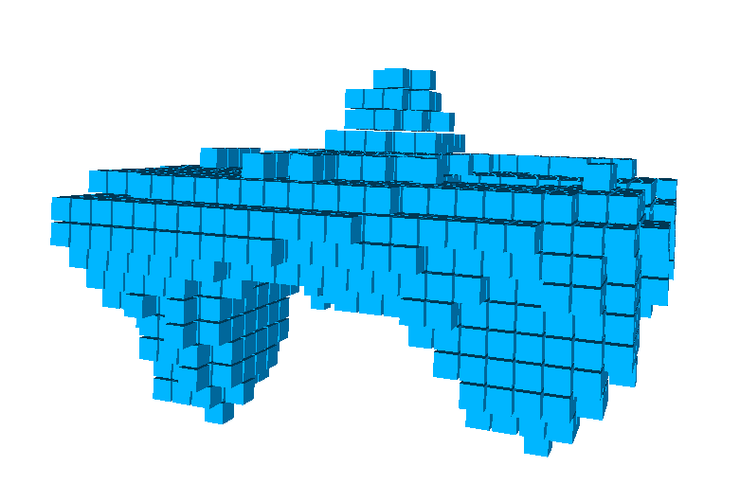
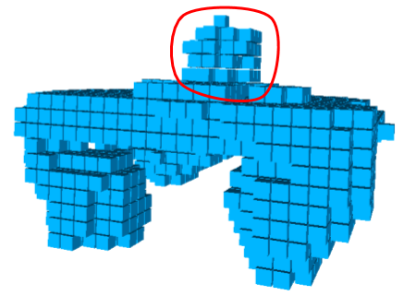
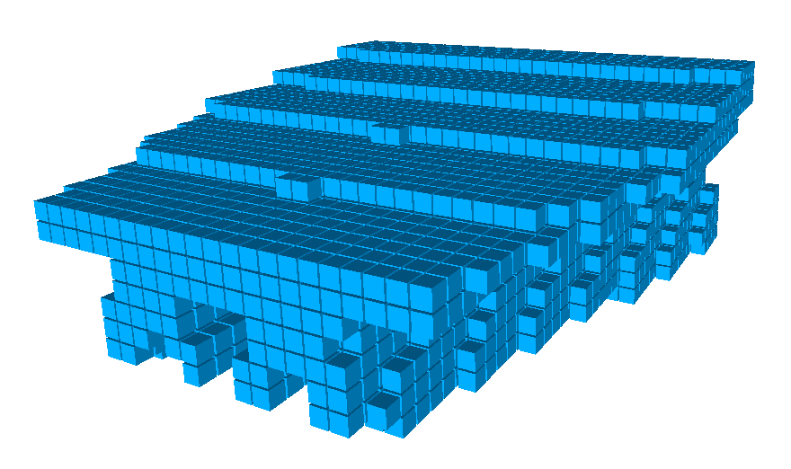
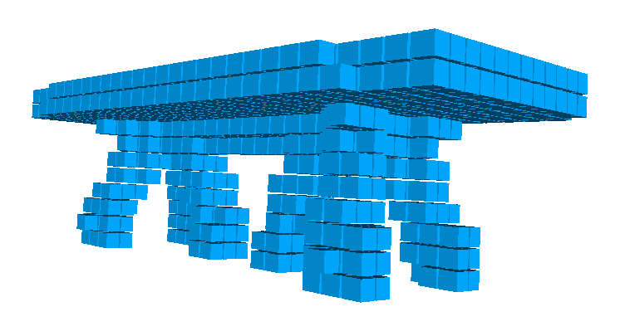
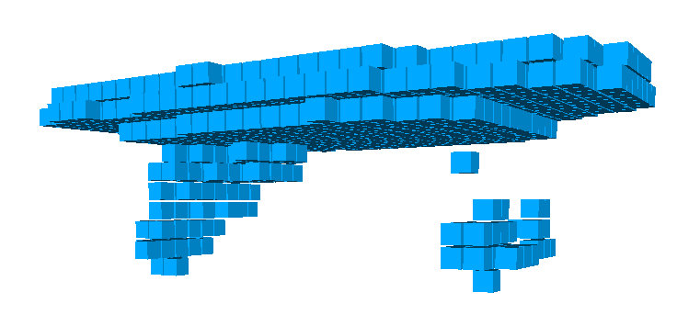
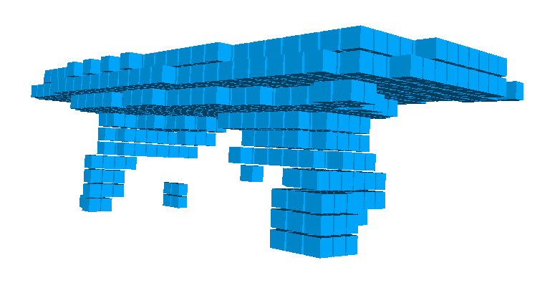
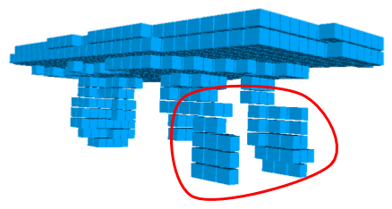

Evaluation : Occupancy Grid vs Distance Field
Input Image
Input Volume
Ground Truth
Occupancy
TDF
TDF(log)
Notes:
From visual results, we can see that df with log transform gives little better predictions than other two cases.
Though the predictions made by Df without log transform looks better in some cases, their geometric accuracy is less (lesser IoU) because tdf gives more false positives (voxels predicted by model to be occupied but unoccupied in GT)

Slide 23
Evaluation : Net3D vs UNet3D
Net3D
No Skip Connections
Approx. 2.3 million parameters
UNet3D
Skip Connections
Approx. 1.3 million parameters

Slide 24
Evaluation : Net3D vs UNet3D
 | Occupancy |  | TDF
 | IoU ↑ | L1-Error ↓ | IoU ↑ | L1-Error ↓
Net3D (2.3M params) | 0.592 | 0.118 | 0.597 | 0.111
UNet3D (1.3M params) | 0.596 | 0.118 | 0.584 | 0.110
UNet3D gives comparable performance with lesser parameters
Skip Connections
In terms of speed, UNet3D performs better
UNet3D : 12 epochs
Net3D: 26 epochs
Notes:
For training the UNet3D network, we have used the Adam optimizer with a learning rate of 0.001 and weight decay of 1e-5. The learning rate is decayed by 0.1 after every 10 epochs. We trained the network for 50 epochs with a batch size of 8.

Slide 25
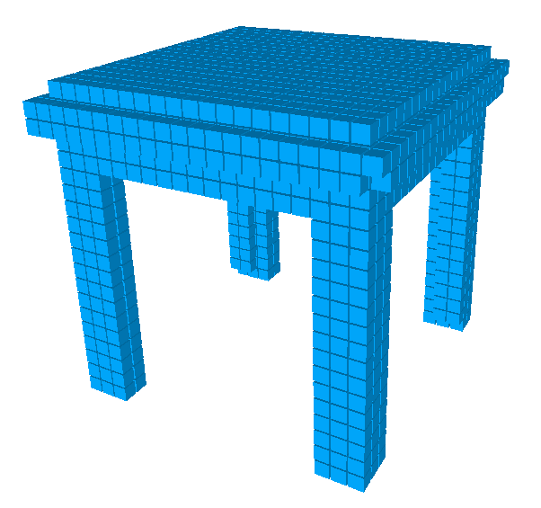
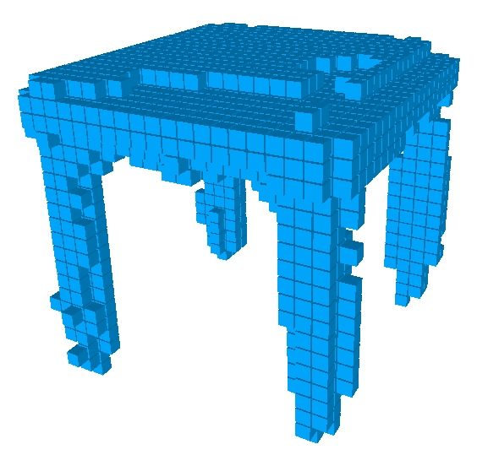
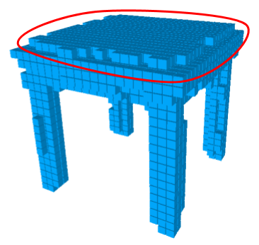
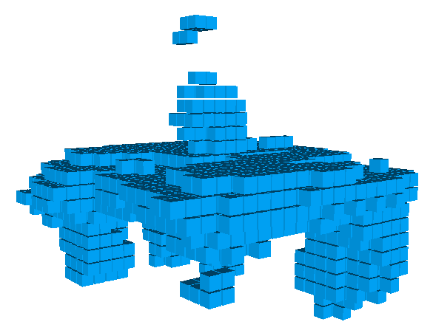
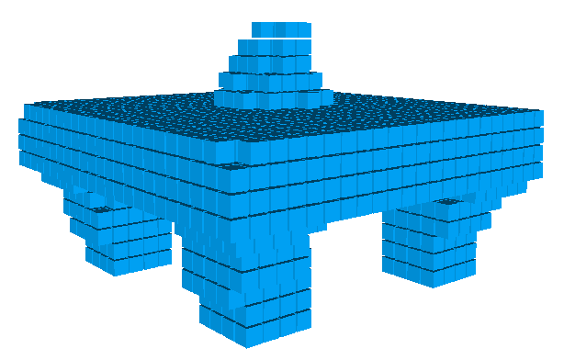
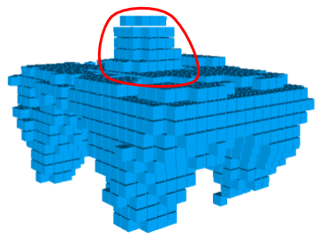
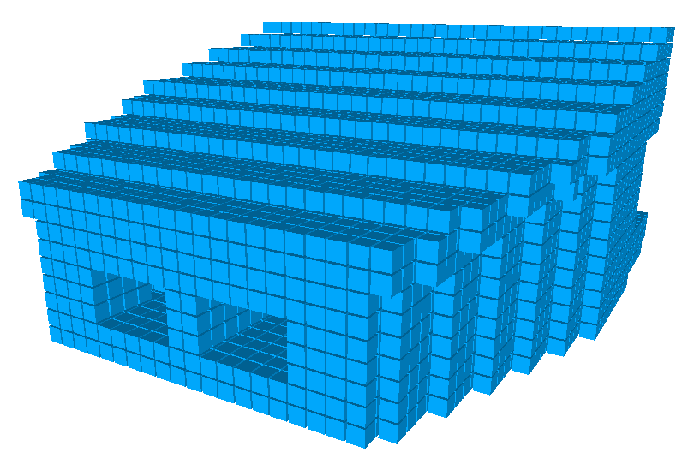
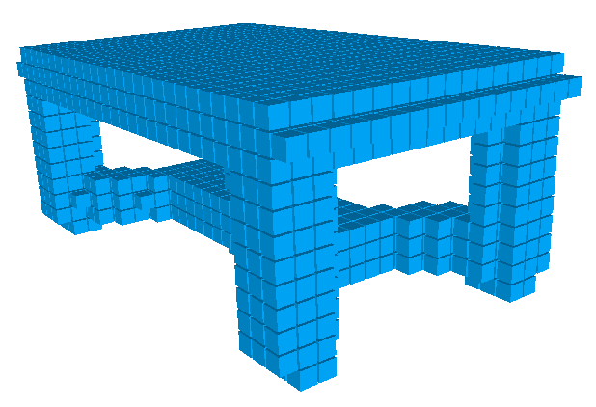
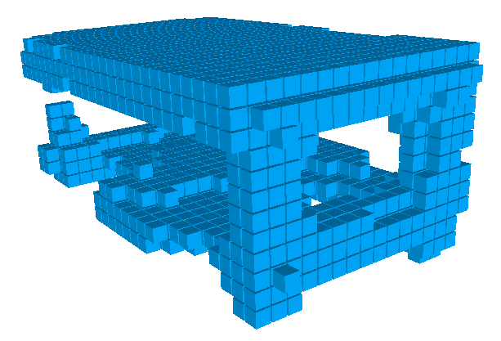
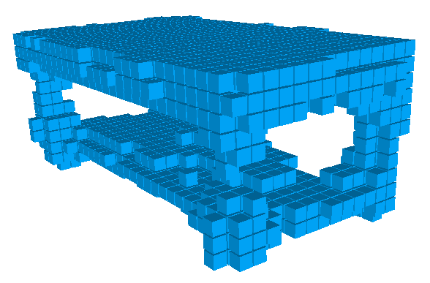
Evaluation : Net3D vs UNet3D
Input Image
Input Volume
Ground Truth
Net3D
UNet3D

Slide 26
Conclusion
Occupancy Grid vs Distance Field (DF) Representation
DF(log) - Better reconstructions
Occupancy - Faster convergence
Net3D vs UNet3D - Skipp connections improve performance
Faster convergence
Lesser parameters
Better reconstructions

Slide 27











Future Work
LOSS
Target Image Silhouettes from n-viewpoints
Input Volume
Input 2D Image
Output volume projected into n-viewpoints
Encoder-Decoder Architecture predicts 3D model
Input projected into camera frustrum to create input volumetric structure

Slide 28

Questions?

Slide 29

Appendix : Occupancy Grid vs Distance Field

Slide 30

Appendix : Occupancy Grid vs Distance Field

Slide 31

Appendix : Net3D vs UNet3D

Slide 32

Appendix : Net3D vs UNet3D

